Slide 1
Maker CHECKER
r. Anand KUMAR

Slide 2
COMPONENTS
Angular Front End
Spring Boot
PostGres Database

Slide 3
FLOWCHART
Login Page
Maker – with Add/Edit options
Checker – with Reject option
Spring Boot
PostGres DB – Customer Details

Slide 4
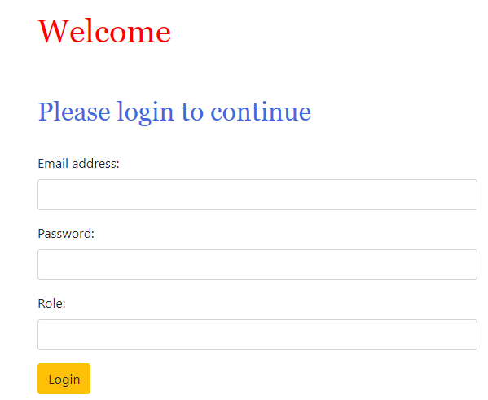
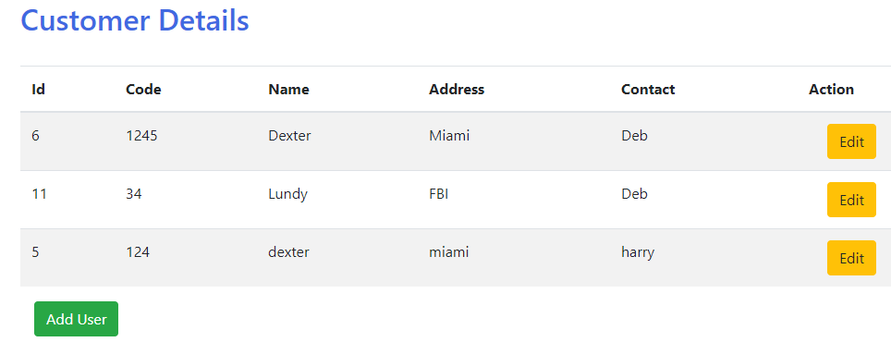
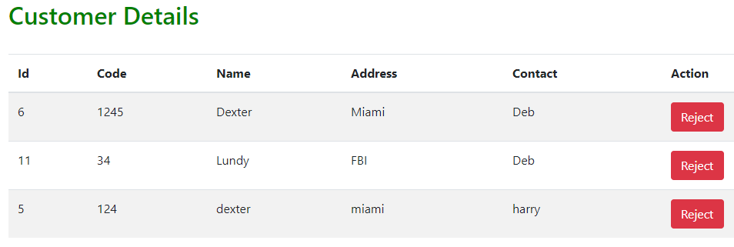
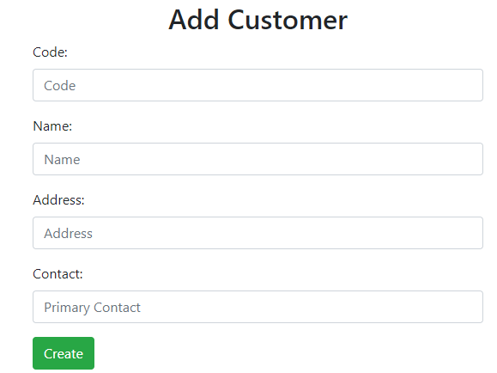
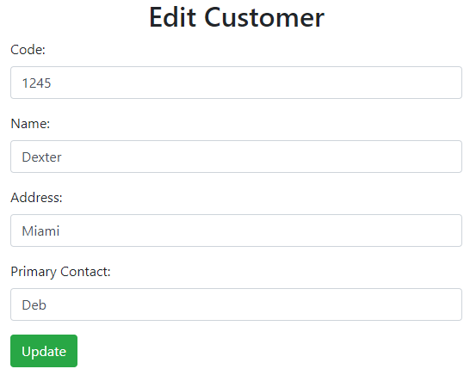
Angular Front END
Login component
List of Components:
Login
List-User
Add-User
Edit-User
Checker
List-User component
Checker component
Add-User component
Edit-User component

Slide 5
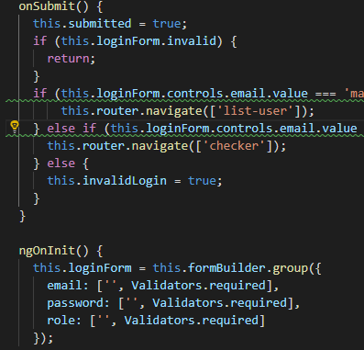
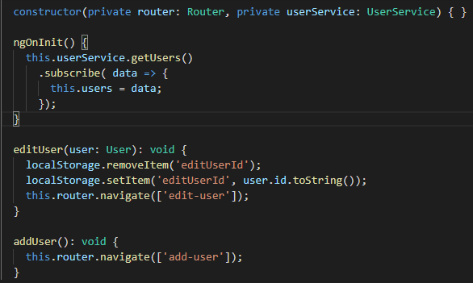
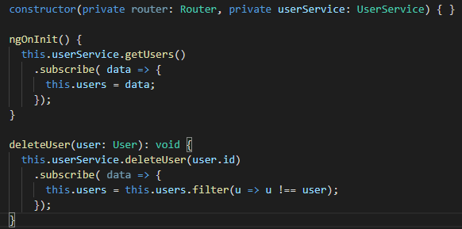
Code SNIPPETS – SAMPLE TS
Login
Maker
Checker

Slide 6
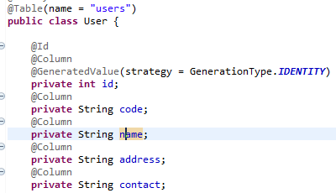
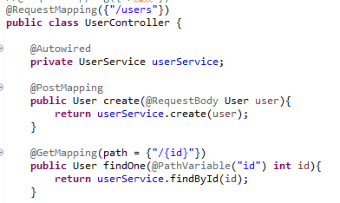
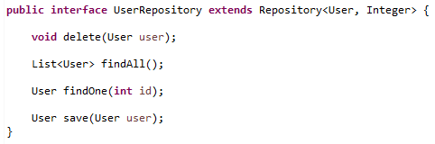
Code SNIPPETS – SAMPLE SPRING BOOT
Entity
Controller
Repository

Slide 7
Testing
As part of project created Login Page and based on role (Maker/Checker) user would be routed to corresponding page.
Maker has option to create and edit existing user details
Checker has the option to reject the data, which causes hard delete from table in DB
Implemented a simple CRUD operation as part of this Project

Slide 8
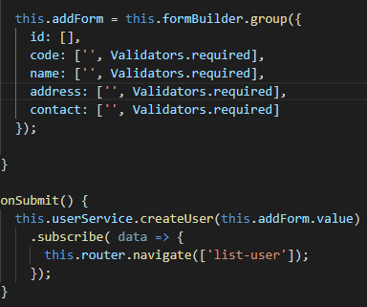
Bugs
The checker concept is not fully developed, currently enabled only reject option.
Validation for add-user is not fully working as it allows empty values in fields even though validation is set to required for the respective form controls

Slide 9
Redesigning The Prototype
As part of prototype upgrade, have to work on implementing actual checker concept, to create the new entry in table only after checker approves the entry.
To enable security to login page and fetch users details from DB table with registration
To use docker to upload the project to enable easier implementation of project in any environment

